Slide 1

Database Project: Explore Care System
Presented by:
Sharon Jepkosgei
EPPS 6354: Information management

Slide 2

Introduction
WHO - Unprecedented growth in proportion of older population worldwide
2020 data – number of individuals above 60 > children below 5 years
By 2030 – 1 in every 5 Americans will be 65 or older
Longer life- enjoy family and pursue new activities
However – decreased mental and physical capacity
Seniors/families make caregiving and healthcare decisions

Slide 3

Explore Care Database: Purpose
Used to build an application for caregiving and healthcare options
California has the largest older population in the US.
By 2052- 26% of the state population will be 65 or above
Explore Care database assembles data:
-rehabilitation centers -cost of care
-nursing homes - physicians
-Evaluate caregiving options through a single application.
- Scaled later

Slide 4
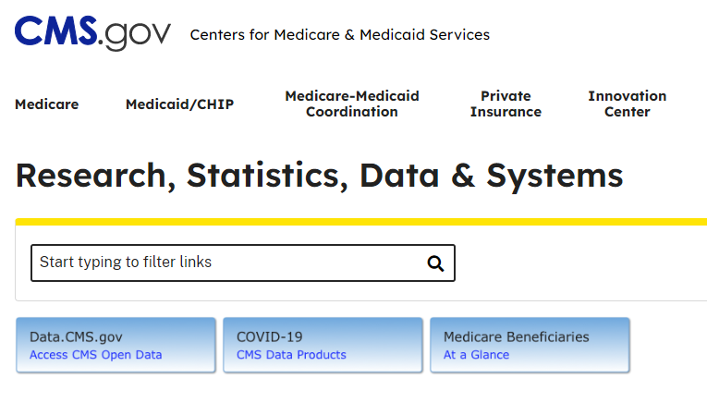
Data
https://www.cms.gov/About-CMS/About-CMS

Slide 5
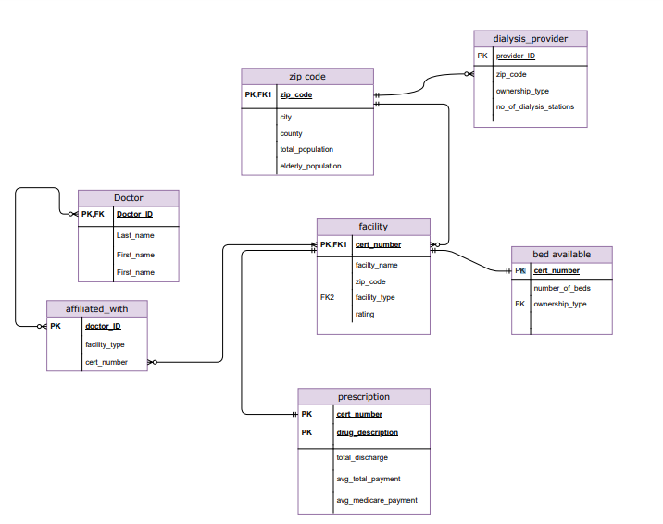
Schema diagram
Schema Diagram for the proposed database

Slide 6
References
Rowlands, Chloe Lee. 2022. “An Aging State: How is California Preparing for the Shift to an Older Population?” Local News Matters, April 1. localnewsmatters.org/2022/03/31/an-aging-state-how-is-california-preparing-for-the-shift-to-an-older-population/.
US Census Bureau. 2021. “Older People Projected to Outnumber Children for First Time in U.S. History.” Census.gov, October 8. www.census.gov/newsroom/press-releases/2018/cb18-41-population-projections.html.
WHO. 2022. “Ageing and Health.” World Health Organization, October 1. www.who.int/news-room/fact-sheets/detail/ageing-and-health#:~:text=By%202030%2C%201%20in%206,will%20double%20(2.1%20billion).

